Slide 1
Investigating the effects of knock on engine thermodynamics
Anisur Rahman Stony Brook University

Slide 2
Introduction
As the demand for electric vehicles grows, there is greater pressure to improve the Internal Combustion Engine (ICE).
In order to meet this new demand, various innovative methods are currently being researched such as alternative combustion methods and engine architectures
There are parameters that can be manipulated to achieve higher efficiencies on spark ignition engines such as operating lean or increasing compression ratio
However, each of this has its own drawbacks
For the higher compression ratio, the draw back is the onset of knock. In order to combat this, spark timing has to be delayed which again decreases efficiency, essentially cancelling the benefits
Knock, by its very nature, is chaotic; similar to turbulent flow. However, there are patterns among this chaos
These patterns and their effects are what will be examined in this presentation

Slide 3
motivation
Determine what makes knock harmful to engine performance
Evaluate thermodynamic properties of knock cycles and how they differ from cycles that don’t knock
Determine the difference in efficiencies and specific fuel consumptions (SFC) between knock and no-knock cycles and how they differ from the mean

Slide 4

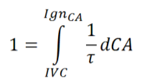
Isolating knock cycles
The cycles that knocked were determined using the graph to the right which was calculated using the equations:
(Lawler 2018) (1)
(Lawler 2018) (2)
Figure 1 shows 1/τ integrated from -120 to 120 degrees after TDC for each individual cycle
It can be seen that not every cycle knocked
The further away from 1 the lines level off at, the larger the degree of knock
Cycles close to 1 moderately knock but are treated as not-knocking because sample size is already low (N=37)

Slide 5
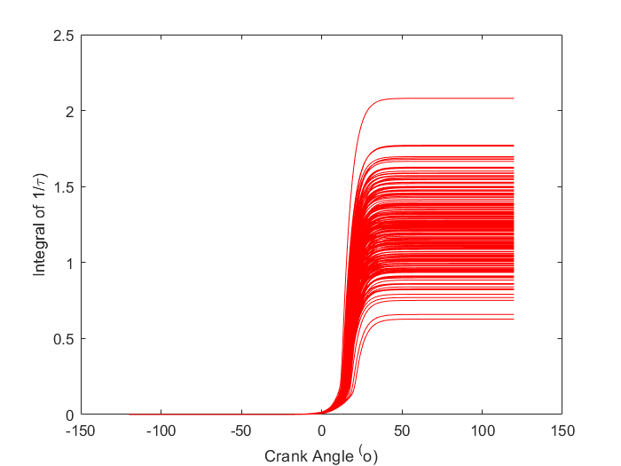
Ignition Delay plot
Figure 1. Ignition Delay vs Crank Angle

Slide 6
Pressure trace
The overlapped pressure traces in figure 2 show that the knock cycles produced higher peak pressures
The difference in their peak pressures is 1.47 bar
However, after the peak pressure subsided, the knock pressures were lower throughout the rest of the expansion stroke
This is due to the fluctuations in pressure caused by knock, stealing energy from the engine and lowering the average pressure (Lawler 2018).

Slide 7
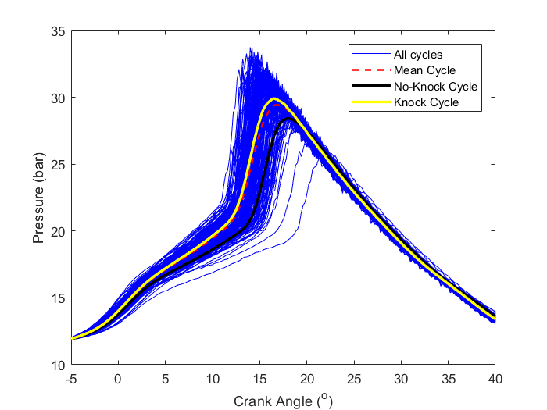
Pressure trace
Figure 2. Pressure vs Crank Angle for all cycles, average knock cycles, and average not-knocking cycles

Slide 8
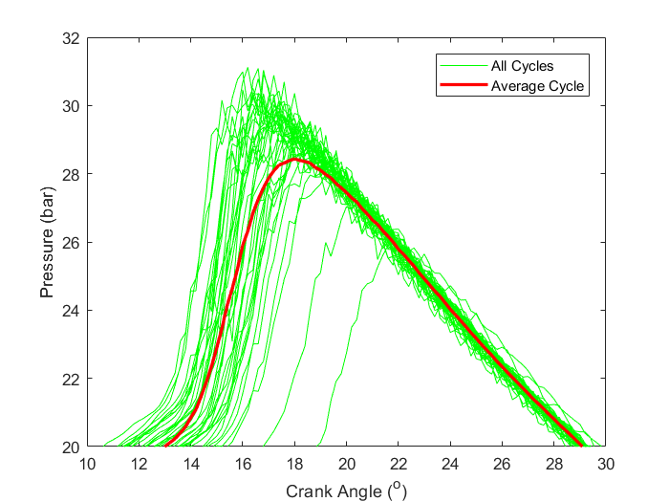
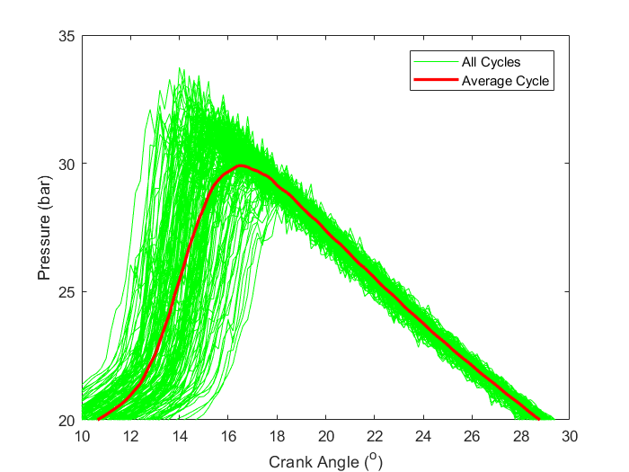
Pressure trace of knock and non-knocking cycles
Figure 3a. Pressure vs Crank Angle for no-knock cycles
Figure 3b. Pressure vs Crank Angle for knock cycles

Slide 9

Simulated pressure
The simulated motoring pressure was achieved by using the equation 3 (Lawler 2018):
(3)
Motored pressure was calculated from -120 to 120 degrees after TDC for different k values
The k value that best matched the pressure trace before combustion was used
k=1.25
Figure 4: Pressure vs Crank Angle for simulated motor pressure

Slide 10
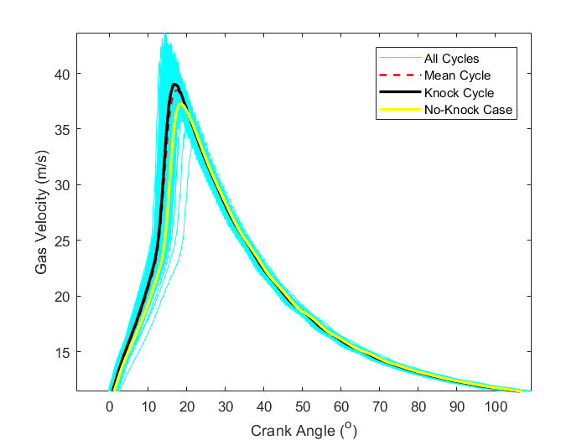

Average gas velocity
Figure 5 shows the average gas velocity in the cylinder from ~0 to ~110 degrees ATDC using equation 4:
(4)
Just as with the pressure trace in figure 2, we see the knock cycles achieve a higher peak and then dip below the knock cases throughout the rest of the expansion stoke
Again this is because the knocking causes the average value to be lower
Figure 5. Average Gas Velocity vs Crank Angle

Slide 11
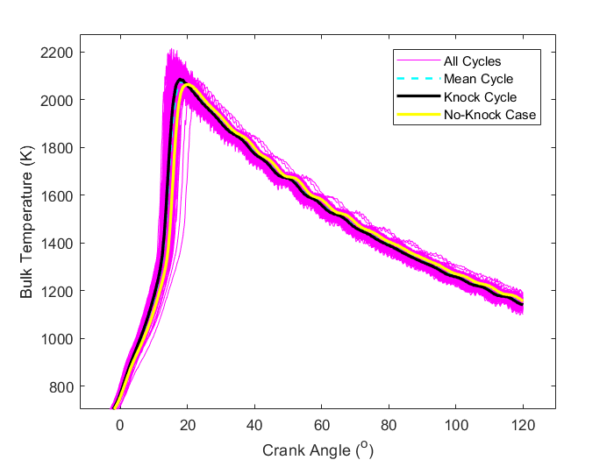
Bulk temperatures
Figure 6 shows the Bulk temperatures vs crank angle for approximately the same crank angle range as figure 5 using the ideal gas relations from lecture 4 (Lawler 2018).
As expected, the gas bulk temperature inside the cylinder is lower for the knock cases throughout expansion after the peak temperature
This correlates with the data in the previous graphs as lower pressures and velocities will coincide with lower temperatures
Figure 6. Bulk Temperature vs Crank Angle

Slide 12
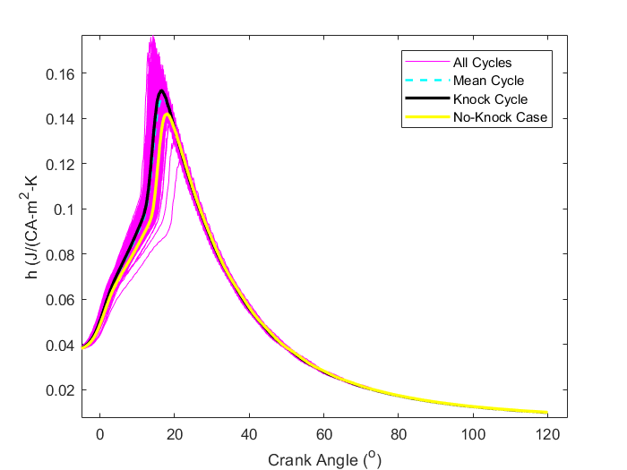

Heat transfer coefficient
Figure 7 shows the heat transfer coefficient, h, in terms of J/CA-m² –K instead of J/s-m²-K traditionally used in heat transfer problems from 0 to 120 degrees ATDC calculated using the equation 5 (Lawler 2018):
(5)
We see the results are consistent with the previous graphs as the h is initially lower for the non-knocking cycles but ends up being higher after the knock cases reach their peak
The initial difference, however, is greater than it was for the gas velocities and bulk temperatures
Figure 7. Heat Transfer Coefficient vs Crank Angle

Slide 13
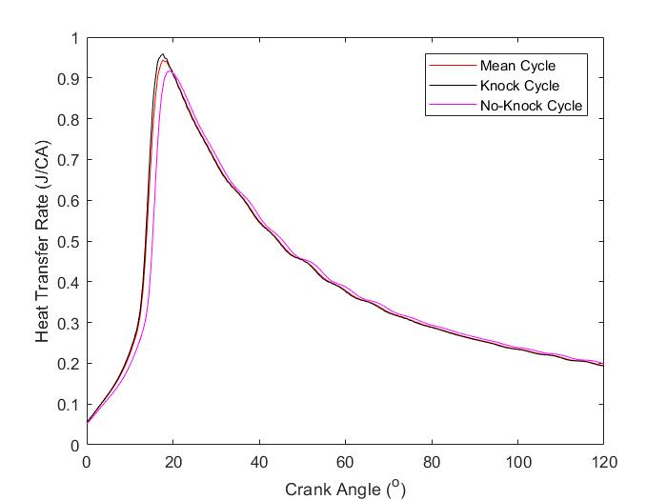
Heat transfer rate
Figure 8 shows the heat transfer rate converted to units of J/CA from 0 to 120 degrees after TDC
The heat transfer rate was calculated using equation 6: (6)
The plot shows that while the initial heat transfer rate for the knock cycles is greater, it too levels off after the peak. The difference is more noticeable than it is with the h plot in figure 7
This is to be expected as the h values and bulk temperatures followed a similar trend so it only makes sense that the heat loss rate does the same
Because the heat loss is a linear relation between those two parameters and has the same Area and T_{wall} values, the difference is not too great
Figure 8. Heat Transfer Rate vs Crank Angle

Slide 14
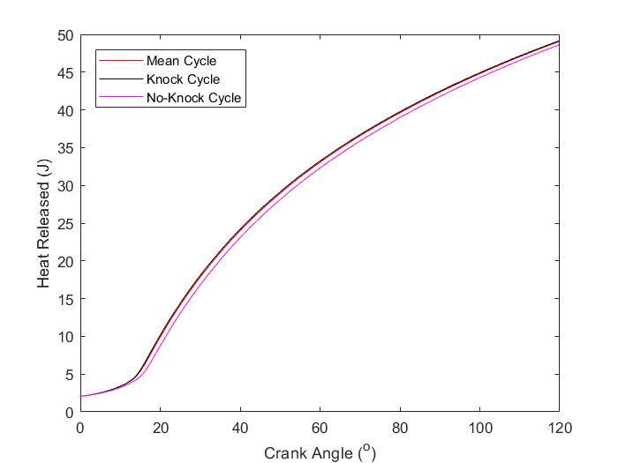
Heat lost
Figure 9 shows the total heat transferred to the wall from 0 to 120 degrees ATDC.
Although the heat loss rates were greater after the peak values, the large initial gap resulted in a slightly lower amount of heat lost for the non-knocking cycles
The difference is small at a value of 0.54 J but is consistent as it is calculated from the average values
Figure 9. Heat Lost vs Crank Angle

Slide 15
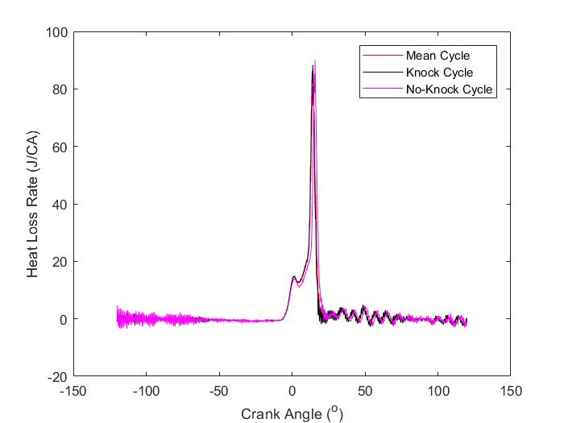

Heat release rates
Figure 10 shows the heat release rates in terms of J/CA from -120 to 120 degrees ATDC . As stated in class, noise is amplified when numerically differentiating. This noise is amplified further by the presence of knock. Even the non-knocking cycles exhibit ringing in the data
The heat release rate was calculated using equation 7 (Lawler 2018):
(7)
The peak heat release rate is slightly higher for the non knocking case which is counter intuitive and does not agree with research conducted by other engineers. In a study done by Zavlava and Folkerts, the peak average heat release rate for knock cycles were higher than non-knocking cycles
As such, this result should not be trusted due to the low number of cycles used to calculate the rates given the large amount of noise.
Figure 10. Heat Lost vs Crank Angle

Slide 16
Heat release rates
Figures 11a and 11b show the mean heat release rate plotted along with the heat release rates of each individual cycle for the non-knocking and knocking cases respectively
While the peak average value for the non knocking case is higher than the peak average value for the knocking case, the individual heat release rates for the knocking cases reach higher values
The difference in the largest peak value for the individual cycles is 60.47 J/CA greater in the knock case

Slide 17
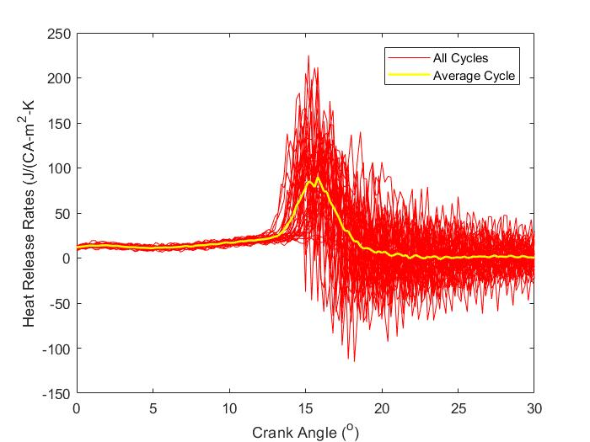
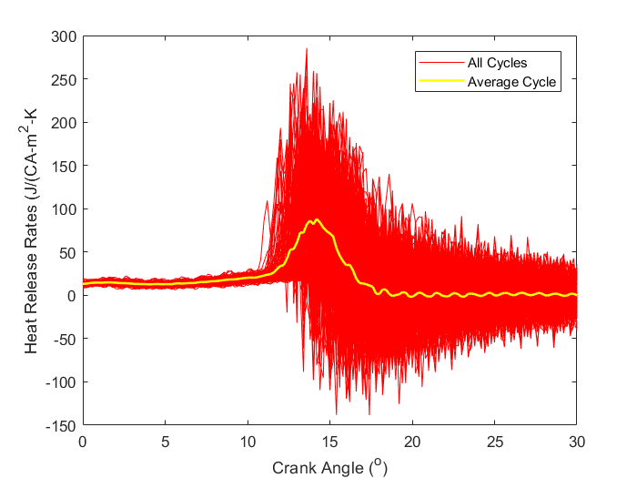
Heat Release rates
Figure 11a. Heat Release Rate vs Crank Angle for non-knocking cycles
Figure 11b. Heat Release Rate vs Crank Angle for knocking cycles

Slide 18
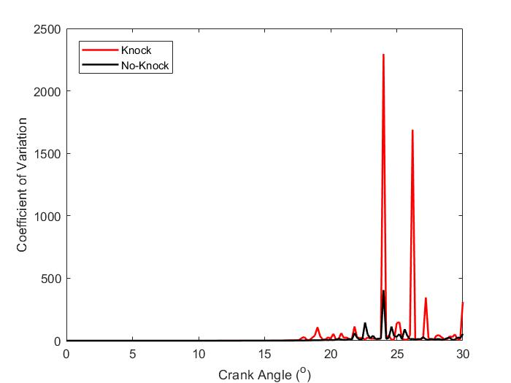
Coefficient of variation
Figure 12 shows the coefficient of variation of the heat release rates for both the knock and non-knocking cycles from 0 to 30 degrees after TDC
It is evident that the knock cycles have much higher variability than the non-knocking cycles during combustion. The peak COV for the knock cycles is 55 times greater than for the non-knocking cycles
The peak difference occurs at around 24 degrees after TDC
The average heat release rate at this point is relatively low as it has leveled off. However, the individual cycles still vary greatly
Figure 12. Average COV for Heat Release Rates vs Crank Angle for knocking and non-knocking cycles

Slide 19
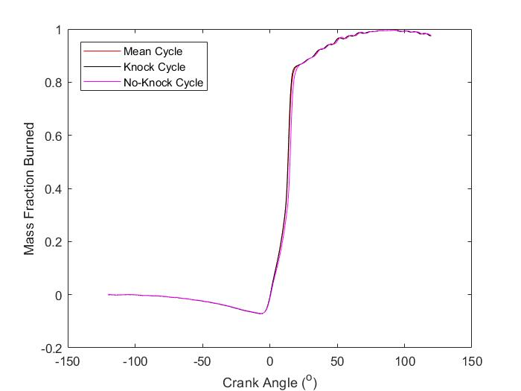
Mass Fraction Burned
Figure 13 shows the mass fraction burned curve for the average knocking and non knocking case along with the average of all 200 cycles
The combustion phasing for the knock cycles is earlier throughout combustion resulting in a slightly earlier CA50
This is a result of the higher heat release rates and peak pressures earlier on in combustion
Figure 13. MFB Curve for mean cycle, mean knocking cycle, and mean non-knocking cycle

Slide 20
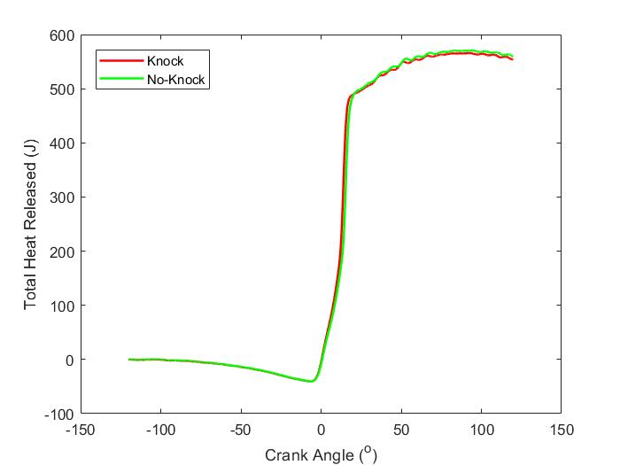
Heat released
Figure 14 shows the heat released from -120 to 120 degrees after TDC for the knocking and non-knocking cases. This was calculated by adding the gross heat released obtained from integrating the average heat release rates shown figure 10 and adding it to the heat lost shown in figure 9 to obtain the net heat released. The MFB curve is obtained from this graph by normalizing by the max values
As seen throughout the presentation, the initial heat released is greater for the knocking cycles but levels starts to level off to a lower value
Unlike with the heat lost graph, the final value for the net heat released is greater for the non-knocking cycles is greater by 5.32 J
Figure 14. Average Net Heat Released vs Crank Angle for knocking and non-knocking cycles

Slide 21
Efficiencies
Figure 15a shows the efficiencies of the mean cycle, the mean knocking cycle, and the mean non-knocking cycle
It is evident that the efficiencies are nearly identical across the board for this analysis
Since the differences are hard to see, figure 15b is shown to illustrate the percent deviation from the mean efficiencies
While the differences are small, there is a trend which shows the non-knocking cases to be slightly more efficient
The mechanical efficiency is lower for the non-knocking case but that is because the same brake power is used for both cases with the non-knocking case having a higher indicated gross power
The equation for calculating mechanical efficiency is shown in equation 8 (Heywood):
η_{mech}=P_{b}/P_{ig} (8)
In reality, the brake power for the non-knocking case would most likely be higher resulting in a higher mechanical efficiency as well

Slide 22
Efficiencies
Figure 15a. Efficiencies of the average cycle, average knocking cycle, and average non-knocking cycle
Figure 15b. Percent Deviation from mean efficiency for average knocking and non-knocking cycle

Slide 23
Specific Fuel Consumptions
Figure 16a shows the net and gross specific fuel consumption for the mean cycle, mean knocking cycle, and mean non-knocking cycle
As expected, the specific fuel consumptions are also very close, there differences almost negligible
Figure 16b illustrates the difference from the mean SFC for the knocking and non-knocking cycle
We see that the specific fuel consumptions are slightly lower for the non-knocking cases as expected. This results in better fuel mileage as more power is transmitted for the same amount of fuel

Slide 24
Specific Fuel Consumptions
Figure 16a. Specific Fuel Consumptions of the average cycle, average knocking cycle, and average non-knocking cycle
Figure 16b. Percent Deviation from mean SFC for average knocking and non-knocking cycle

Slide 25
Conclusion
The large variations caused by knock are far too high during combustion and results in unpredictable and uncontrollable cycles
The specific fuel consumptions for the knocking cases are higher than for the non-knocking cases, resulting in less fuel economy
While the peak pressures for the knocking cycles are greater than for the non-knocking cycles, the ringing in the cylinder caused by knock steals energy from the engine leading to lower total power output and efficiency
The drawbacks of knock outweigh the slight increase in peak pressures early in combustion

Slide 26
References
Dessus, B., Martinez, N., Delarue, C., and Nespo, F., "Electric Vehicles in Europe and the
Environment: a Prospect Analysis," SAE Technical Paper 94A052, 1994.
Lawler, B. (2018). Lecture 4. [PowerPoint slides]. Retrieved from
https://blackboard.stonybrook.edu/webapps/blackboard/execute/content/file?cmd=view&content_id=_4614829_1&course_id=_1171678_1
Lawler, B. (2018). Lecture 5. [PowerPoint slides]. Retrieved from
https://blackboard.stonybrook.edu/webapps/blackboard/execute/content/file?cmd=view&content_id=_4621282_1&course_id=_1171678_1
Lawler, B. (2018). Lecture 6. [PowerPoint slides]. Retrieved from
https://blackboard.stonybrook.edu/webapps/blackboard/execute/content/file?cmd=view&content_id=_4633671_1&course_id=_1171678_1
Lawler, B. (2018). Lecture 7. [PowerPoint slides]. Retrieved from
https://blackboard.stonybrook.edu/webapps/blackboard/execute/content/file?cmd=view&content_id=_4633672_1&course_id=_1171678_1

Slide 27
References continued
Lawler, B. (2018). Lecture 9. [PowerPoint slides]. Retrieved from
https://blackboard.stonybrook.edu/webapps/blackboard/execute/content/file?cmd=view&content_id=_4644676_1&course_id=_1171678_1
Lawler, B. (2018). Lecture 11. [PowerPoint slides].
https://blackboard.stonybrook.edu/webapps/blackboard/execute/content/file?cmd=view&content_id=_4647612_1&course_id=_1171678_1
Sesay, J. (2018). Renewable Energy- an Overview. [PowerPoint slides]. Retrieved from
https://blackboard.stonybrook.edu/webapps/blackboard/content/listContent.jsp?course_id=_1171675_1&content_id=_4589122_1&mode=reset
Zavala, J. and Folkerts, C., "Knock Detection and Estimation Based on Heat Release Strategies,”
SAE Technical Paper 2011-01-1409, 2011,
https://doi.org/10.4271/2011-01-1409.

